Slide 1
Predicting Car brand by Deep-learning

Slide 2
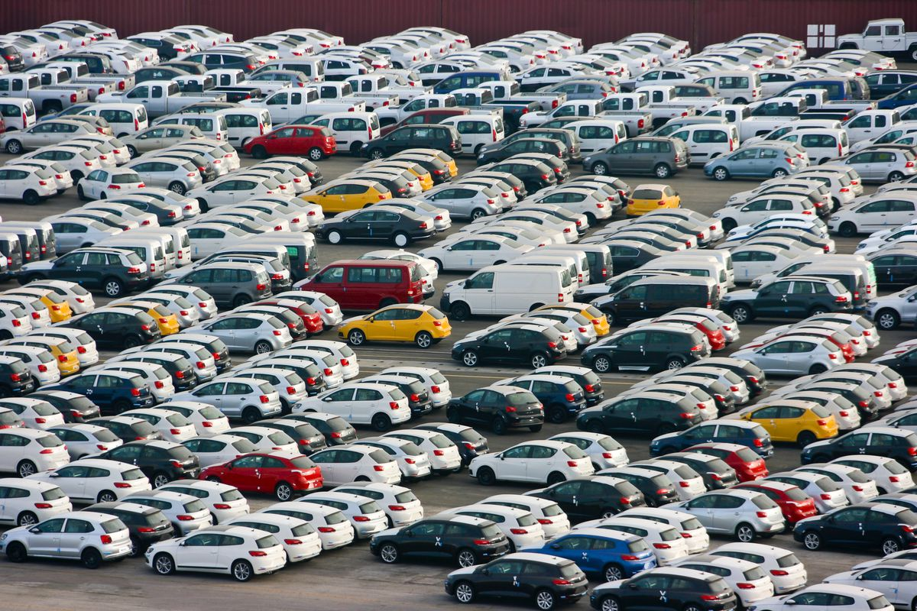
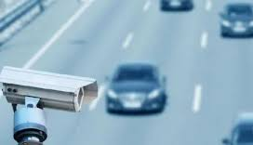
Motivation
Information collection
Traffic violation
Public interest

Slide 3
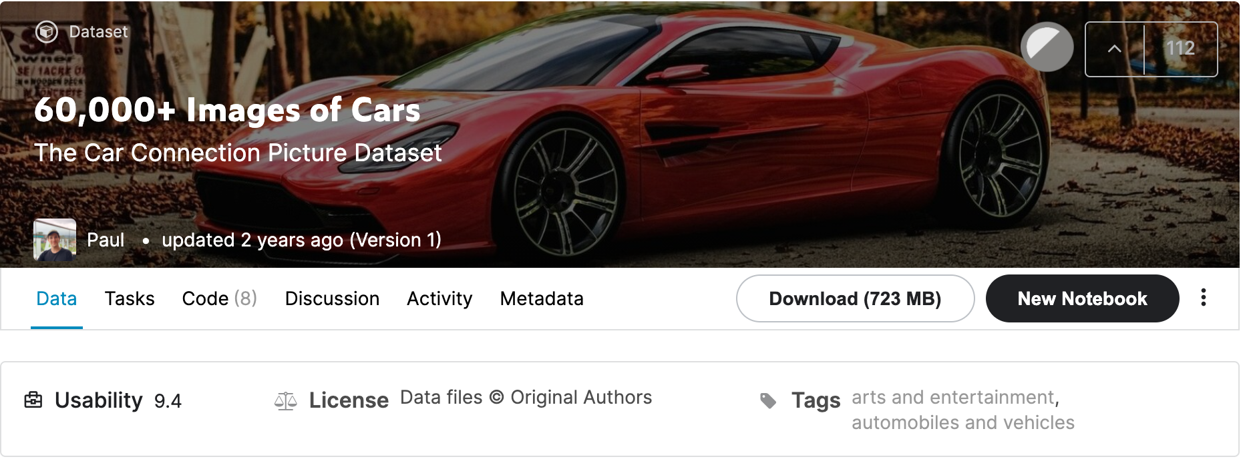
Dataset

Slide 4
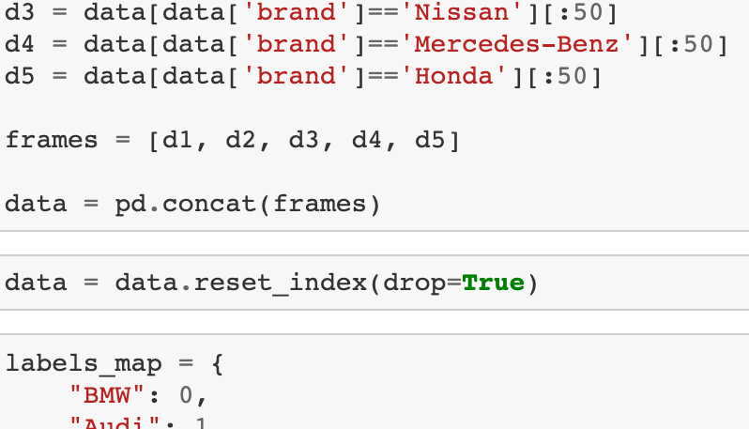
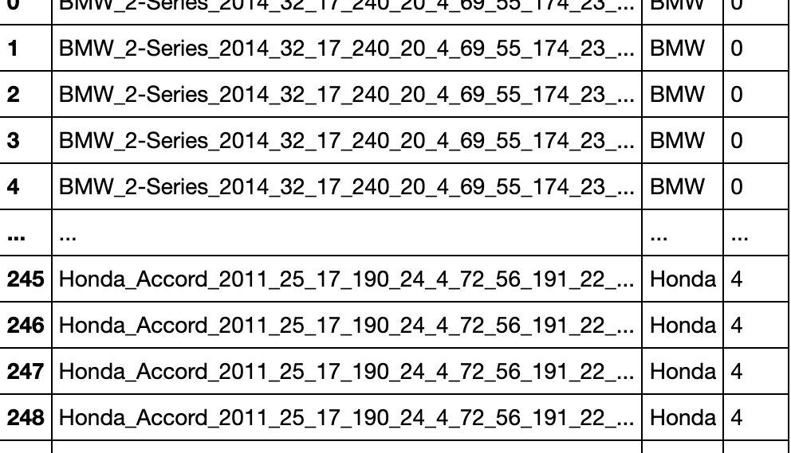
Brand chosen
BMW
Audi
Nissan
Mercedes-Benz
Honda

Slide 5
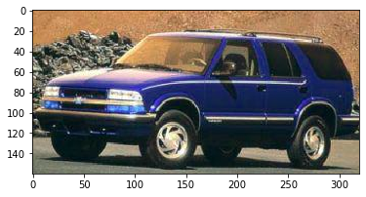
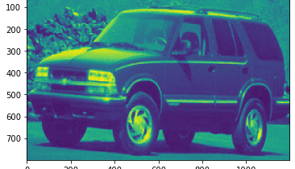
Super resolution
FSRCN Model

Slide 6
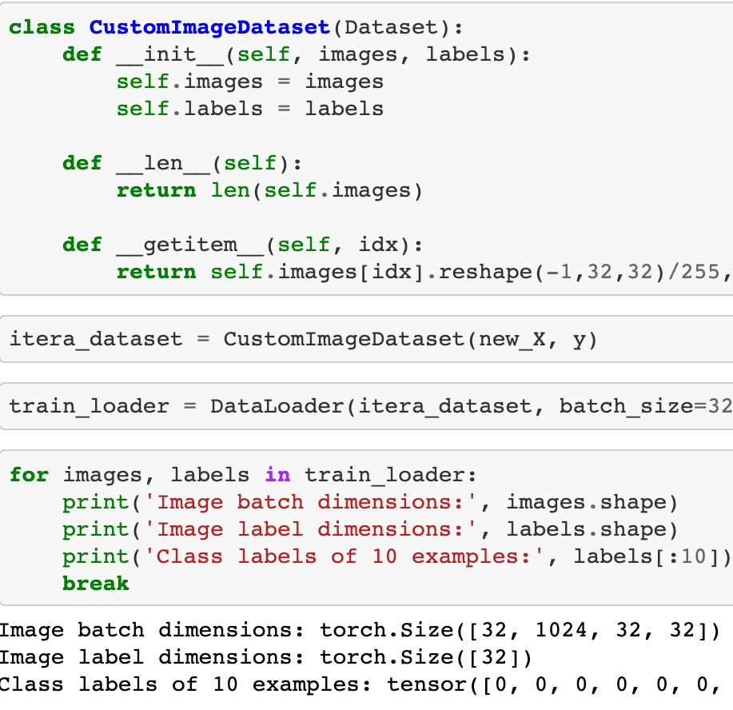
Data loader

Slide 7
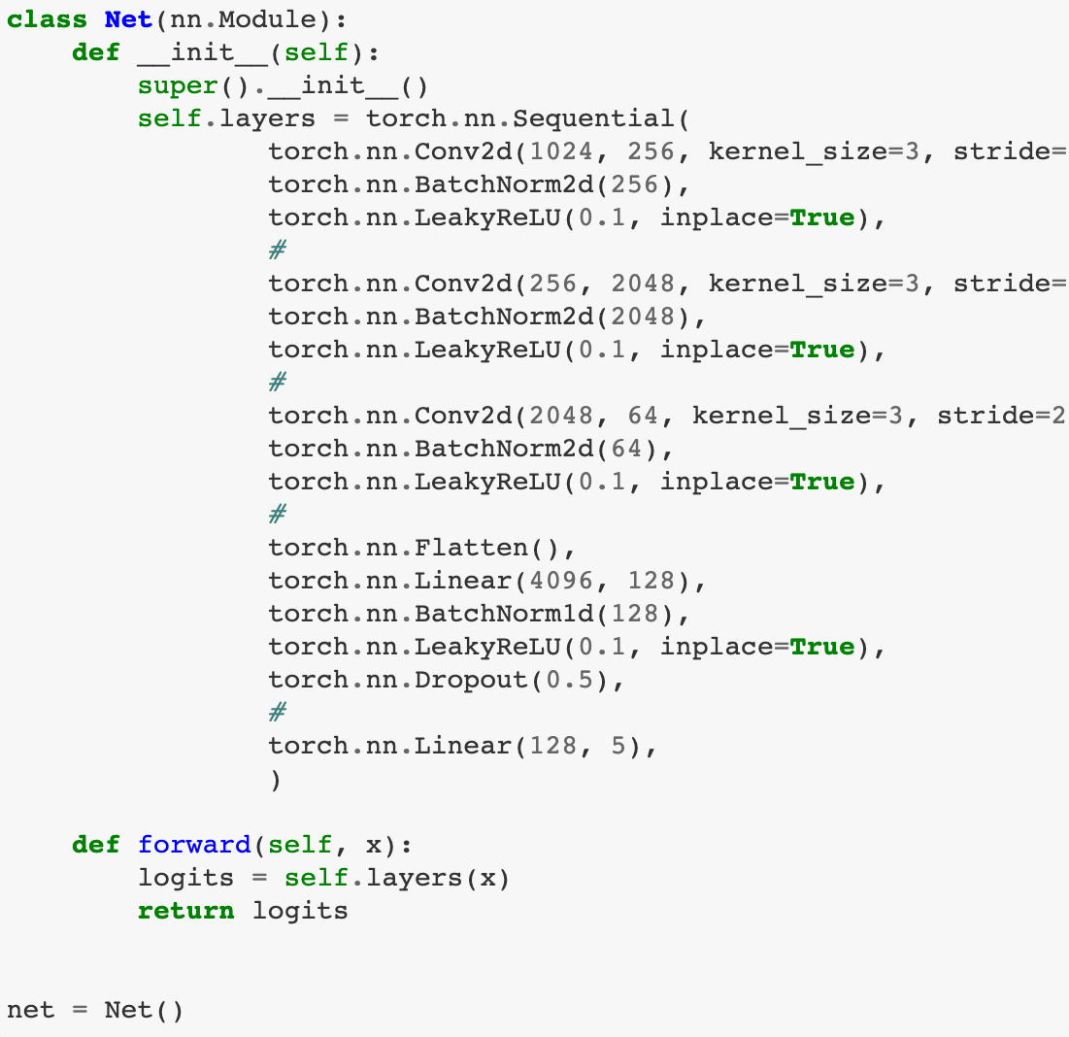
CNN model

Slide 8
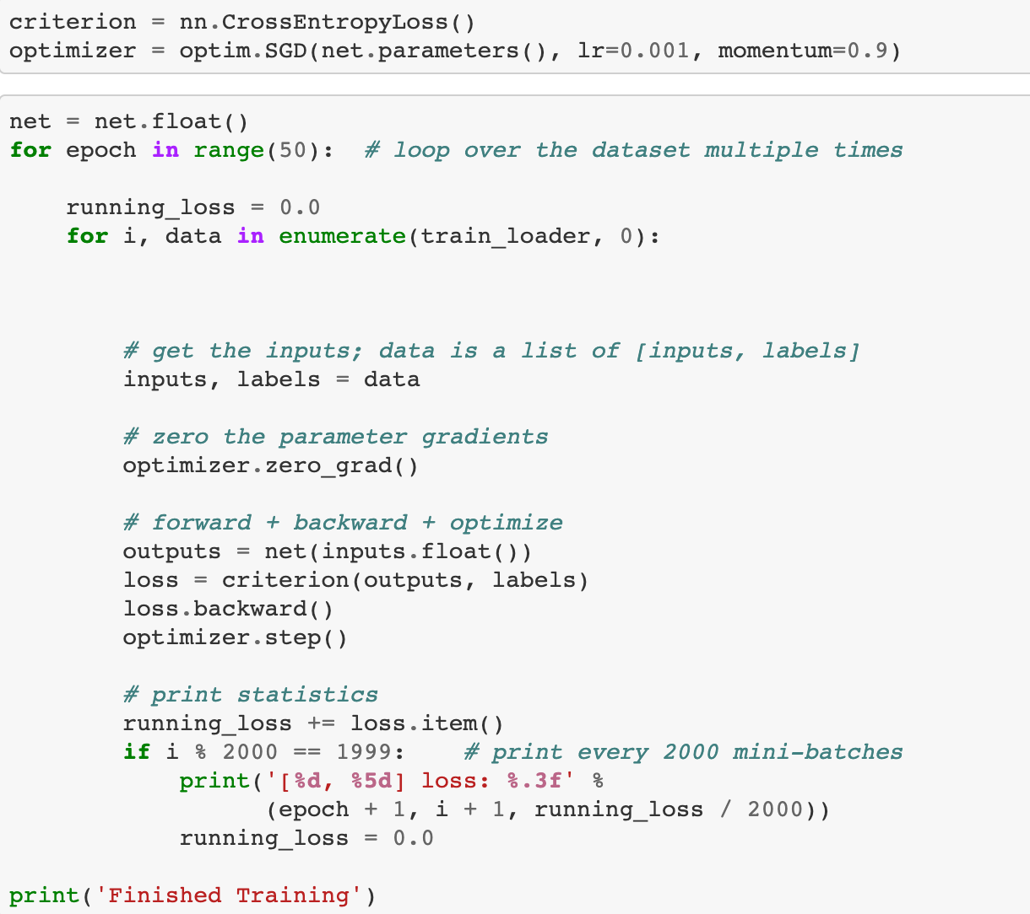
Trainning

Slide 9
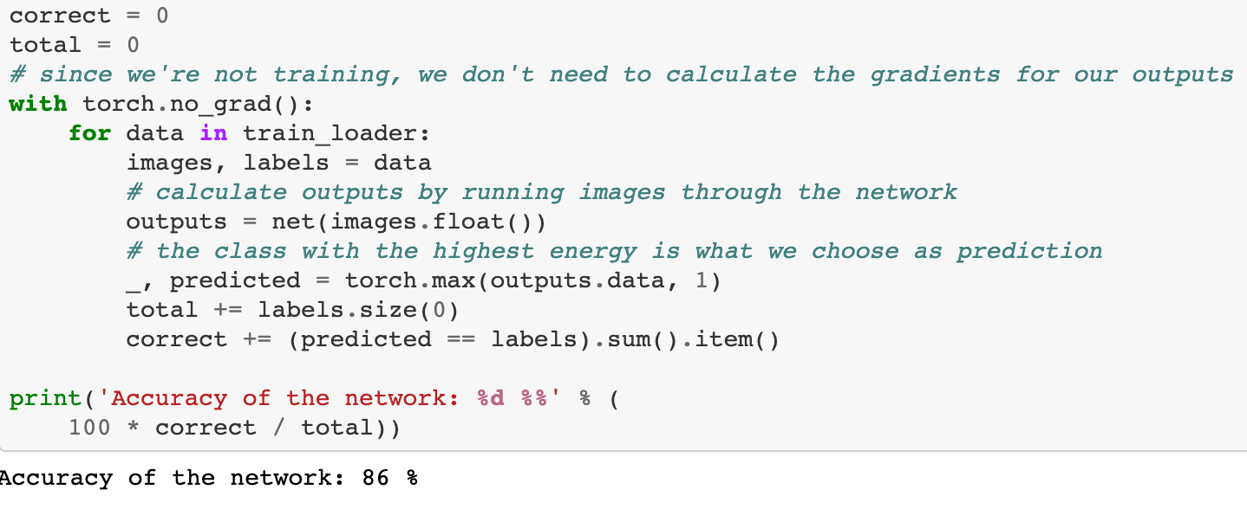
Predicting
86%

